Slide 1
Managing Continuous Improvement Presentation.
Analysis of Chapter Four.

Slide 2
Introduction.
Human beings need to be disciplined and committed to attaining their set goals.
Human brains tend to favor short-term rewards than long-term efforts (Medinilla, 2014).
Teams are more essential in identifying and addressing complex individual problems.
Notes:
According to the author, human beings are required to remain disciplined as well as committed to meet their needs and set goals. In many settings, human brains tend to disregard long-term efforts in consideration of short term ideas and rewards. There is a need to condition our brains in how to sacrifice as well as self-control in an effort to configure them accurately (Medinilla, 2014). Teams are more essential in identifying and addressing complex individual problems.

Slide 3
Key points from the chapter.
Basic rules for problem-solving teams.
  Small.
  Cross-functional.
  Self-organized.
  Future driven (Medinilla, 2014).
  Collaborating.
Notes:
Agile teams are likely to encompass few members between 4 to 10 members. A good team should be cross-functional by having all team members having the same skills and work on the same tasks (Medinilla, 2014). All member should be focused on identifying and diagnosing issues amid the team while focusing on the future for maximum flexibility. Members should collaborate to work on the same issue.

Slide 4
Continuation on Key points from the chapter….
Team Identity.
  Noble cause.
  Shared values
  Cultural artifacts (Medinilla, 2014).
  Physical artifact.
  Behavioral artifacts.
Notes:
A good team is identified in a noble basis. Likely members must be focused on the same values such as quality and perfection (Medinilla, 2014). A team can also be identified with behavioral and physical artifacts, aspects which define a common way of working as well as managing group data

Slide 5
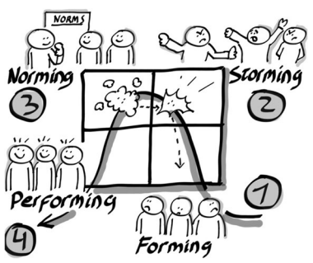
Continuation on Key Points From the Chapter……
Tuckman’s four-stage model of a team growing.
  Forming.
  Storming.
  Norming.
  Performing (Medinilla, 2014).
Real World Example:
  Dee Dee Trotter – 2008 Summer Olympics.
Notes:
To grow a sound team, it is essential to consider the contribution of Tuckman’s four-stage model for team development. The first step is forming which require an understanding of the fact that every individual is only focused on meeting personal goals (Medinilla, 2014). Storming stage, members are committed to knowing each other and collaborate despite different views. In the norming phase, members get work on common goals. Performing phase, the team is fully grown, and members rely on skills and capabilities to carry out group tasks.
In regard to the example, Dee had won her first Olympic gold medal in 2004. In 2008 Olympics, she was to participate in the 4 by 400 meters’ relay. Due to prevalent injuries, Dee ended up withdrawing from the team in the last minute, believing that her best would have destroyed the team. Members collaborated with her assertions, a replacement was done immediately, and the team ended up claiming the Olympic gold medal.

Slide 6
Conclusion.
Agile teams are always focused on accomplishing the set goals.
It is always essential to follow the key principles when defining your team.
Tuckman’s four-stage model is paramount for a team growing.
Notes:
Agile teams are always focused on accomplishing the set goals. It is always essential to follow the key principles when defining your team and behavioral artifacts (Medinilla, 2014). Tuckman’s four-stage model is paramount for a team growing in all setting.

Slide 7
Reference.
Medinilla, A. (2014). Agile Kaizen: Managing continuous improvement far beyond retrospectives.

